Slide 1
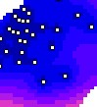


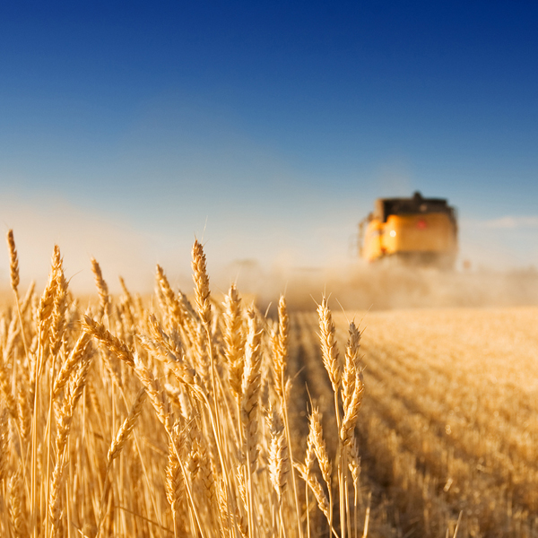
Introduction to uncertainty analysis in spatial environmental modelling
Kasia Sawicka and Gerard Heuvelink
Vienna, 24 April 2017

Slide 2
Uncertainty propagation overview
Input ± U
Model (± U)
Output ± U
Model
output
Model
parameters
Input
data
Solution
method
Model
structure
Observ.
data
Data ± U

Slide 3
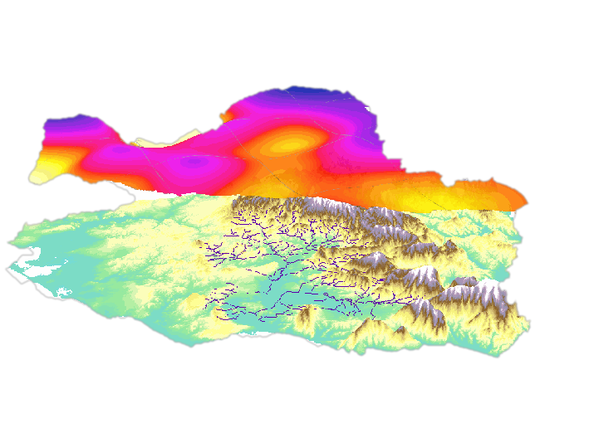
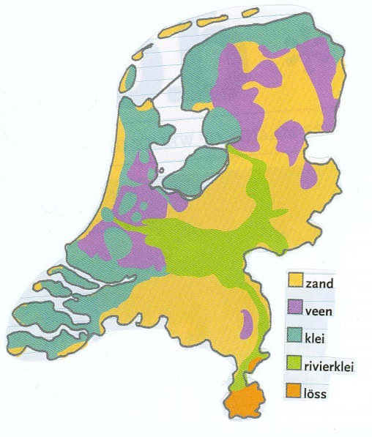
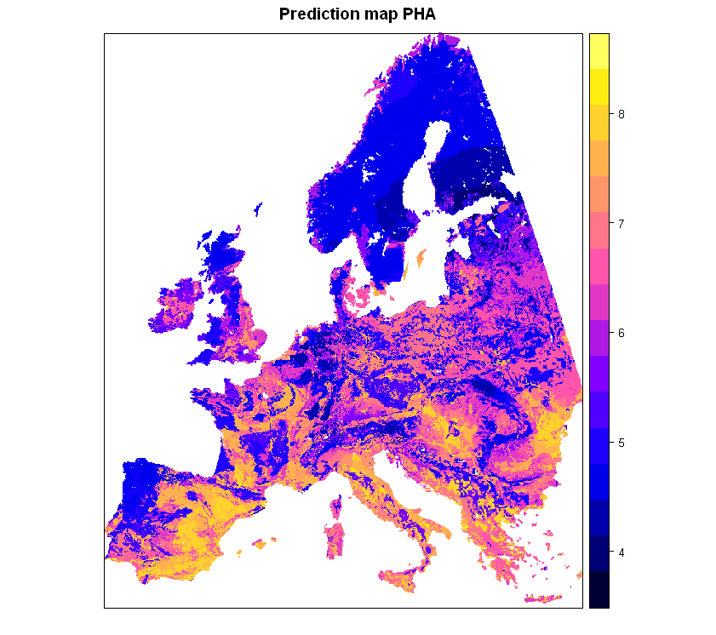

Environmental data vary in space
E.g. Rainfall
Categories like soil type
Environmental quality indicators like soil pH
Notes:
As a part of the QUICS project a new tool for uncertainty propagation analysis is developed as a package in R. The Package focuses, but is not limited to, spatial uncertainty analysis.
It is becasue environmental variables vary in space. Like rainfall, soil type, or other environmental quality indicators, for example soil pH.

Slide 4
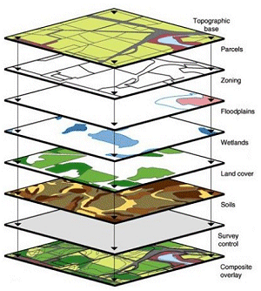
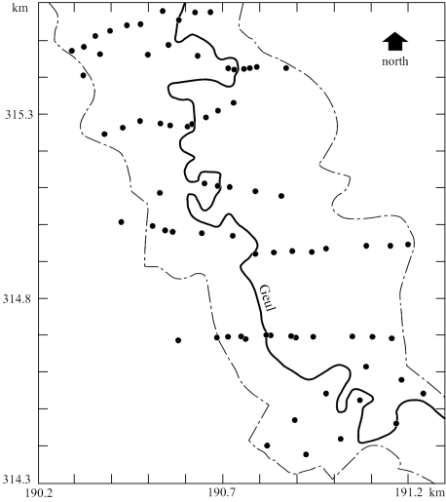
Deriving maps is encumbered with error
E.g. interpolation error or error associated with maps derived from other maps
input map A₁
input map A₂
input map A_{m}
Output map
Notes:
The space variation is often displayed by a mean of maps created using various interpolation techniques, for example kriging from point observations or deriving maps from other maps (like DEM and slope) and thus naturally encumbered with interpolation errors. The patterns of uncertainty in space are important because the impacts of correlated error may differ substantially from those associated with random error.

Slide 5
Fact of life: maps stored in the GIS database are rarely if ever error-free
Causes: generalisation, digitisation, measurement, classification and interpolation errors
Consequence: errors will propagate through GIS operations and spatial models
Key research question: given the errors in the inputs to the GIS operation, how large are the errors in the output?

Slide 6
Uncertainty propagation analysis involves three steps:
DEFINITION of a (statistical) uncertainty model for spatial objects and attributes
IDENTIFICATION of the uncertainty model (estimate its parameters)
Perform the actual UNCERTAINTY PROPAGATION ANALYSIS

Slide 7
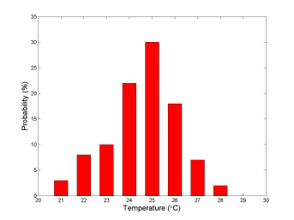
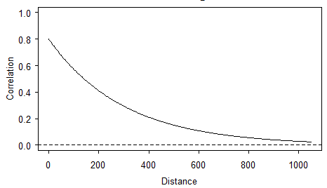
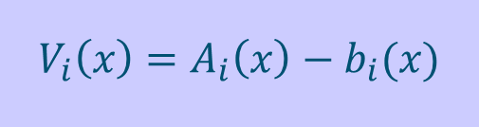
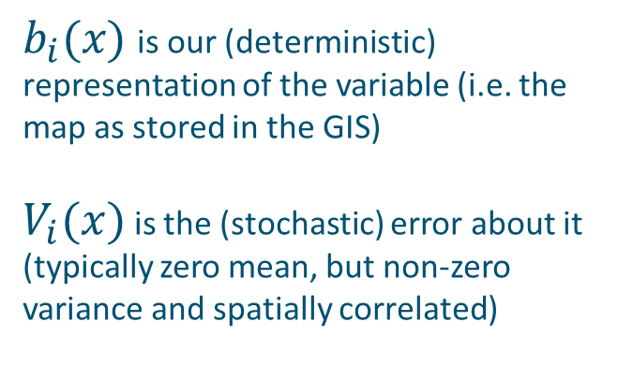
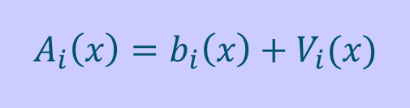
DEFINE and IDENTIFY a (statistical) uncertainty model
DEFINITION
IDENTIFICATION
$$A_{i}\left(x\right)=b_{i}\left(x\right)+V_{i}(x)$$
Marginal pdf at each location (both its shape and parameters)
Spatial correlation (correlogram or semivariogram)
Cross-correlation with other uncertain inputs
$b_{i}(x)$ is our (deterministic) representation of the variable (i.e. the map as stored in the GIS)
$V_{i}(x)$ is the (stochastic) error about it (typically zero mean, but non-zero variance and spatially correlated)
$$V_{i}\left(x\right)=A_{i}\left(x\right)−b_{i}(x)$$
Notes:
Identify uncertainty model
Measurement error from instrument and lab specifications, or by taking replicates (always let laboratories analyse duplicates, without telling them!)
Sampling error using sampling theory from statistics (e.g. standard error of the mean, confidence intervals)
Use of ground truth verification data (e.g. control points)
Interpolation error using geostatistics (kriging)
Errors in transfer functions such as regression: R-square
Classification error using multivariate statistics (e.g. maximum likelihood classification remote sensing imagery)
Expert judgement or Expert elicitation (last resort?)

Slide 8
Performing the actual UNCERTAINTY PROPAGATION ANALYSIS
Taylor series approximation method
Monte Carlo method

Slide 9
Monte Carlo method
Introduce by means of an example

Slide 10
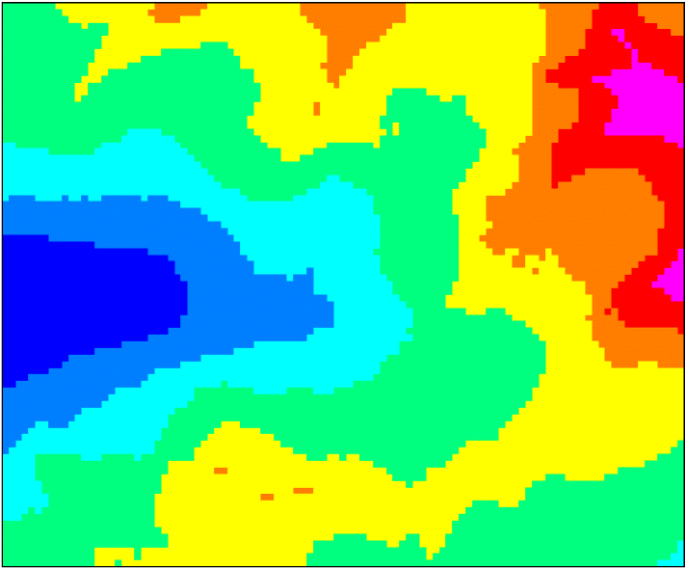
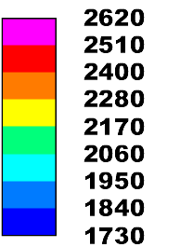
Example: computing slope from DEM for a 2 by 2.5 area in the Austrian Alps

Slide 11
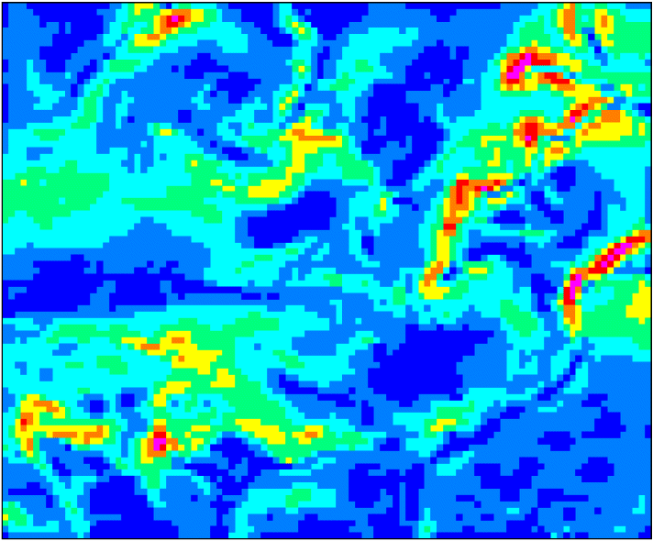
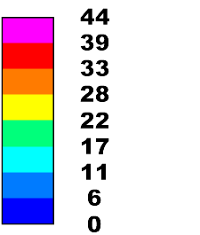
Slope map computed from the DEM (percent):

Slide 12
Now let the uncertainty about the elevation be ± 10 meter

Slide 13
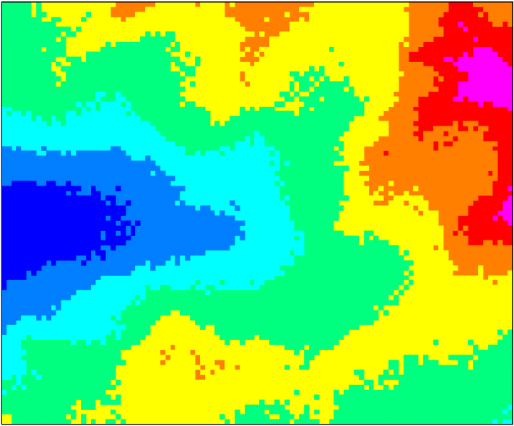
Realisations of uncertain DEM:

Slide 14
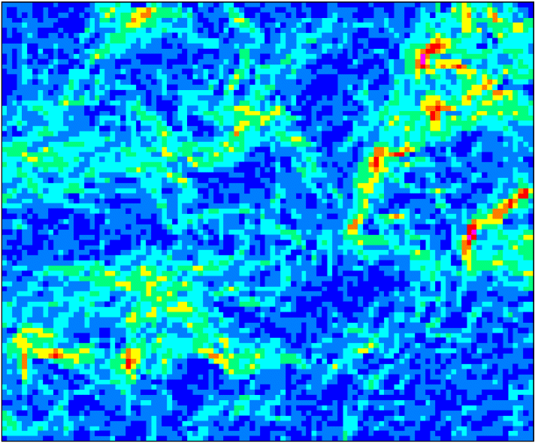
Corresponding slope maps:

Slide 15
Histograms capture uncertainty in slope:

Slide 16
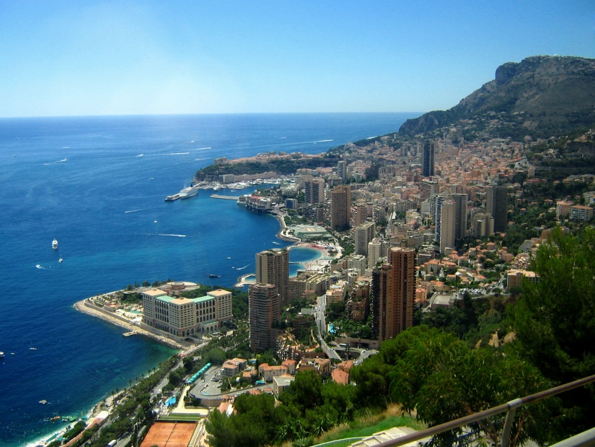

Monte Carlo algorithm:
Repeat N times (N ≥ 100):
Simulate a realisation from the probability distribution of the uncertain inputs using a pseudo-random number generator
Run the model with these inputs and store the result
Analyse the N model outputs by computing summary statistics such as the mean and standard deviation (the latter is a measure of the output uncertainty)

Slide 17
Performing the actual UNCERTAINTY PROPAGATION ANALYSIS
Taylor series approximation method
Monte Carlo method
Advantages Monte Carlo method:
Yields the full output pdf, not only the mean and variance
Works with any model
Easy to implement

Slide 18
Monte Carlo method with spatial inputs
Requires that we simulate from the probability distribution of a spatially distributed variable
Can be done with spatial stochastic simulation: instead of kriging, which produces the most likely value (conditional expectation), we generate a possible reality, by simulating from the probability distribution of the spatial variable, using a pseudo-random number generator
Spatial correlations are taken into account
Most popular technique is sequential Gaussian simulation

Slide 19
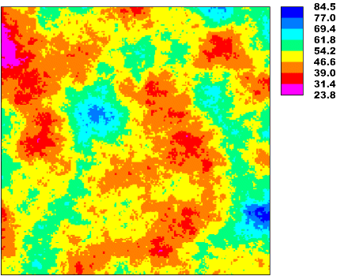
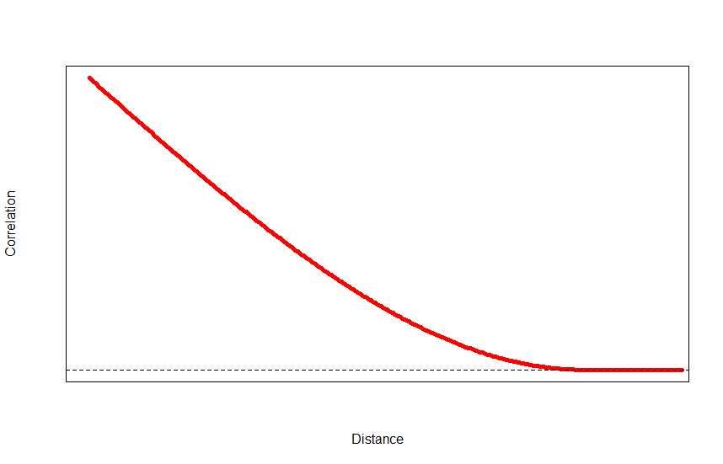
Why is it important to include spatial correlation?
Example 1: a possible ‘reality’
1.0
Correlation
Distance

Slide 20
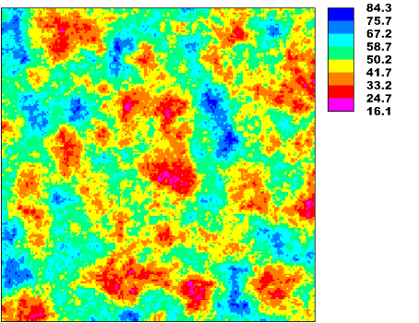
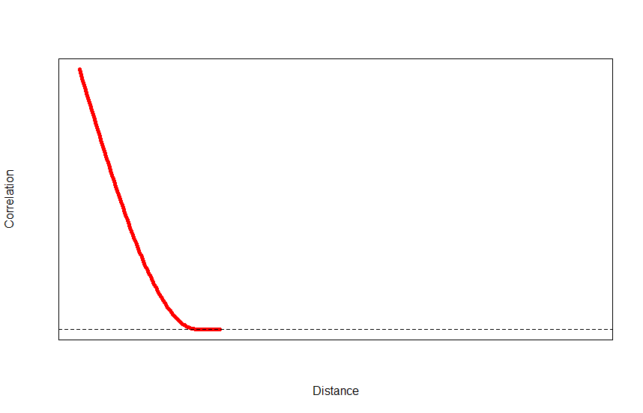
Why is it important to include spatial correlation?
Example 2: second reality
1.0
Correlation
Distance

Slide 21
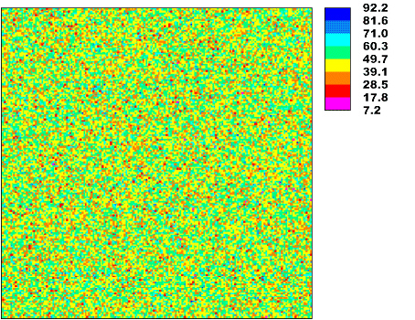
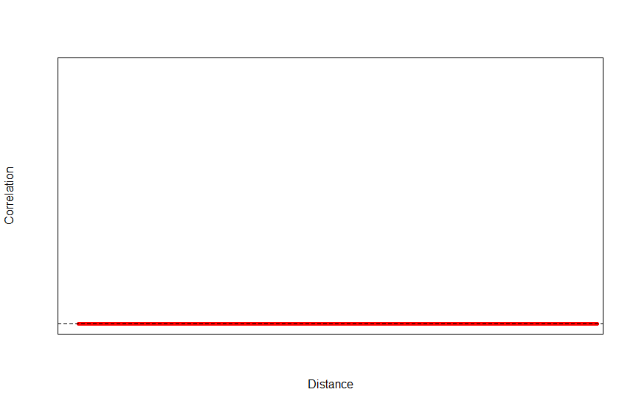
Why is it important to include spatial correlation?
Example 3: third reality
Correlation
0
Distance

Slide 22
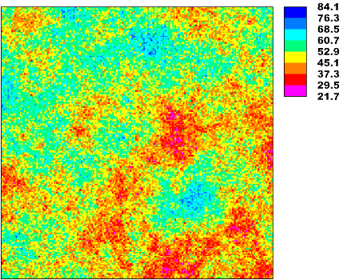
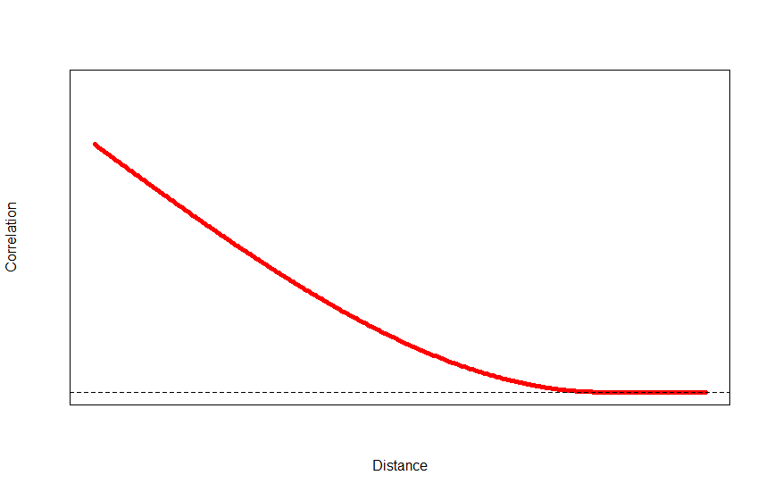
Why is it important to include spatial correlation?
Example 4: fourth reality
1.0
0.8
Correlation
Distance

Slide 23
Why is it important to include spatial correlation?

Slide 24
Computer exercise:
Analyse how uncertainty in DEM map of Zlatibor region in Serbia propagates to slope calculations and its suitability for skiiing tourism
Check how uncertain the DEM and slope suitability map is, and where in Zlatibor it is most uncertain
Identify areas in Zlatibor for which you are 90% certain that the suitability is above the 10 deg. threshold
DEM
Slope
https://github.com/ksawicka/SUPA_EGU2017

Slide 25
Practical excersise – calculating slope from DEM and assosiated uncertainty propagation
DEM
Slope
Required:
R >= v.3.3.3
Packages
spup
sp
gstat
GGally
gridExtra
purrr
magrittr
Notes:
It could be used for models like you’ve seen at earlier presentations, e.g. MiStat presented by Arturo, or wastewater treatment plant models, or other.

Slide 26


https://github.com/
ksawicka
‘spup’ repository

Slide 27
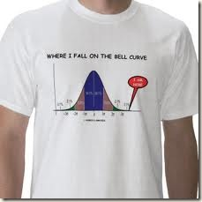
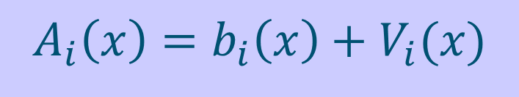
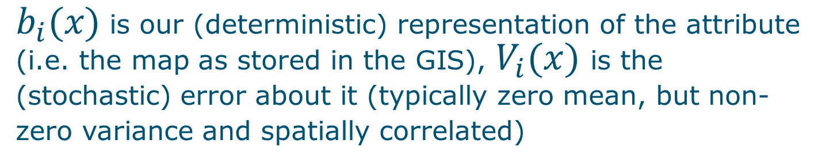
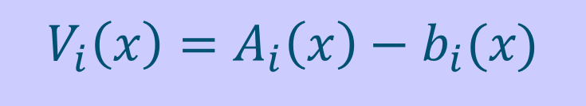
1. DEFINITION of the uncertainty model (concentrate on continuous-numerical attributes)
$$A_{i}\left(x\right)=b_{i}\left(x\right)+V_{i}(x)$$
$b_{i}(x)$ is our (deterministic) representation of the attribute (i.e. the map as stored in the GIS), $V_{i}(x)$ is the (stochastic) error about it (typically zero mean, but non-zero variance and spatially correlated)
Error is difference between reality and our representation of reality:
$$V_{i}\left(x\right)=A_{i}\left(x\right)−b_{i}(x)$$

Slide 28

Statistical model of $V_{i}(x)$ must include:
Marginal pdf at each location (both its shape and parameters)
Spatial correlation (correlogram or semivariogram)
Temporal correlation (for dynamic variables)
Cross-correlation with other uncertain inputs

Slide 29

2. IDENTIFICATION of the uncertainty model
Measurement error from instrument and lab specifications, or by taking replicates (always let laboratories analyse duplicates, without telling them!)
Sampling error using sampling theory from statistics (e.g. standard error of the mean, confidence intervals)
Use of ground truth verification data (e.g. control points)
Interpolation error using geostatistics (kriging)
Errors in transfer functions such as regression: R-square
Classification error using multivariate statistics (e.g. maximum likelihood classification remote sensing imagery)
Expert judgement or Expert elicitation (last resort?)
In practice, this may well be the most difficult step of the entire uncertainty propagation analysis

Slide 30

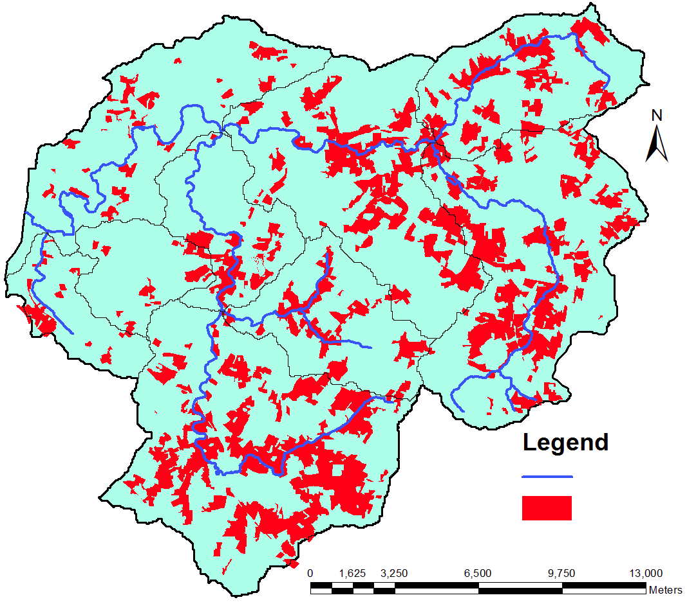
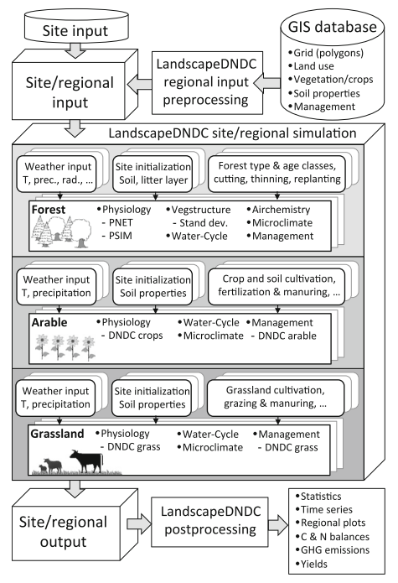
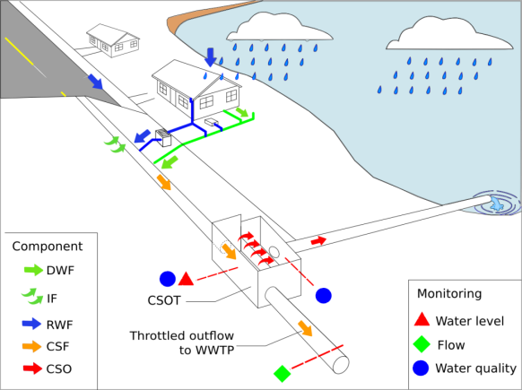
Potential applications
Pollution models (here, Metaldehyde Prediction Model)
Biogeochemical models (here, process-based model LandscapeDNDC
Risk map
Urban drainage models
Haas et. al. (2013)
Notes:
Now, probably the most interesting thing for you is that the ‘spup’ package would also have a potential for use in industry. It could be used for models like you’ve seen at earlier presentations, e.g. MiStat presented by Arturo, or wastewater treatment plant models, or other.

